Slide 1
Introduction
to
Microsoft Excel

Slide 2
Working with Formulas and Functions

Slide 3
Objectives Overview
How to use cell references to create a simple formula in excel
How to create a complex formula in excel
How absolute and relative cell references are used in excel
How to use different parts of a function
How to create arguments to calculate values and cell references

Slide 4
Excel - Introduction to Formulas
One of the most powerful features in Excel is the ability to calculate numerical information using formulas.
Just like a calculator, Excel can add, subtract, multiply, and divide.
In this lesson, we'll show you how to use cell references to create simple formulas.

Slide 5
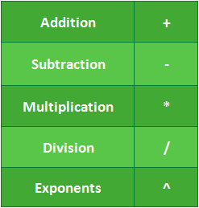
Mathematical operators
Excel uses standard operators for formulas: a plus sign for addition (+), minus sign for subtraction (-), asterisk for multiplication (*), forward slash for division (/), and caret (^) for exponents.
All formulas in Excel must begin with an equals sign (=).
This is because the cell contains, or is equal to, the formula and the value it calculates.

Slide 6
Understanding cell references
While you can create simple formulas in Excel using numbers (for example, =2+2 or =5*5), most of the time you will use cell addresses to create a formula.
This is known as making a cell reference.
Using cell references will ensure that your formulas are always accurate because you can change the value of referenced cells without having to rewrite the formula.

Slide 7
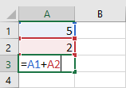
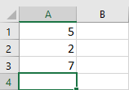
Understanding cell references
In the formula below, cell A3 adds the values of cells A1 and A2 by making cell references:
When you press Enter, the formula calculates and displays the answer in cell A3:

Slide 8
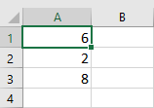
Understanding cell references
If the values in the referenced cells change, the formula automatically recalculates:

Slide 9
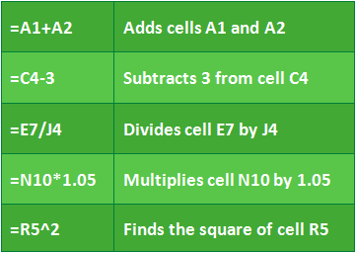
Understanding cell references
By combining a mathematical operator with cell references, you can create a variety of simple formulas in Excel.
Formulas can also include a combination of cell references and numbers, as in the examples below:

Slide 10
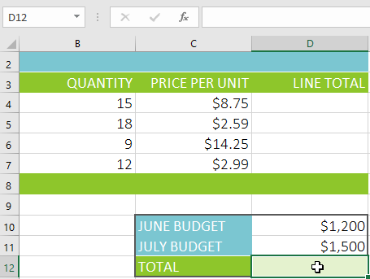
To create a formula
In our example below, we'll use a simple formula and cell references to calculate a budget.
Select the cell that will contain the formula. In our example, we'll select cell D12.

Slide 11

To create a formula
Type the equals sign (=) in the formula bar. Notice how it appears in both the cell and the formula bar.

Slide 12
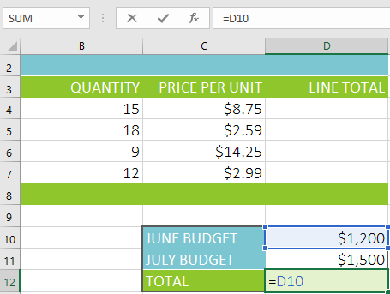
To create a formula
Type the cell address of the cell you want to reference first in the formula: cell D10 in our example. A blue border will appear around the referenced cell.

Slide 13
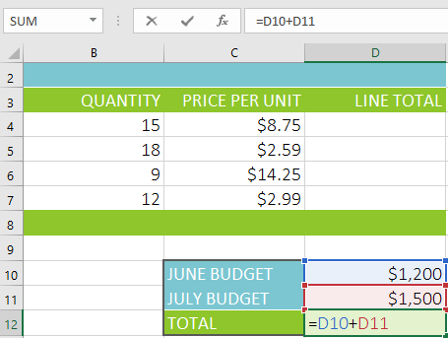
To create a formula
Type the mathematical operator you want to use. In our example, we'll type the addition sign (+).
Type the cell address of the cell you want to reference second in the formula: cell D11 in our example. A red border will appear around the referenced cell.

Slide 14
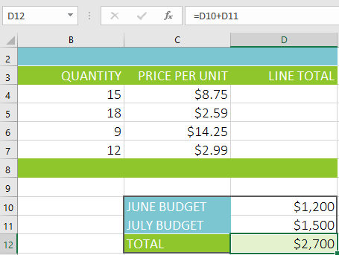
To create a formula
Press Enter on your keyboard. The formula will be calculated, and the value will be displayed in the cell. If you select the cell again, notice that the cell displays the result, while the formula bar displays the formula.

Slide 15
To create a formula
NOTE:
If the result of a formula is too large to be displayed in a cell, it may appear as pound signs (#######) instead of a value.
This means the column is not wide enough to display the cell content.
Simply increase the column width to show the cell content.

Slide 16
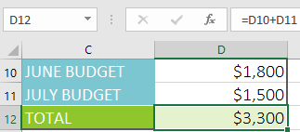
Modifying values with cell references
The true advantage of cell references is that they allow you to update data in your worksheet without having to rewrite formulas.
In the example below, we've modified the value of cell D10 from $1,200 to $1,800. The formula in D12 will automatically recalculate and display the new value in cell D12.

Slide 17
To create a formula using the point-and-click method
Instead of typing cell addresses manually, you can point and click the cells you want to include in your formula.
This method can save a lot of time and effort when creating formulas.
In our example below, we'll create a formula to calculate the cost of ordering several boxes of plastic silverware.

Slide 18
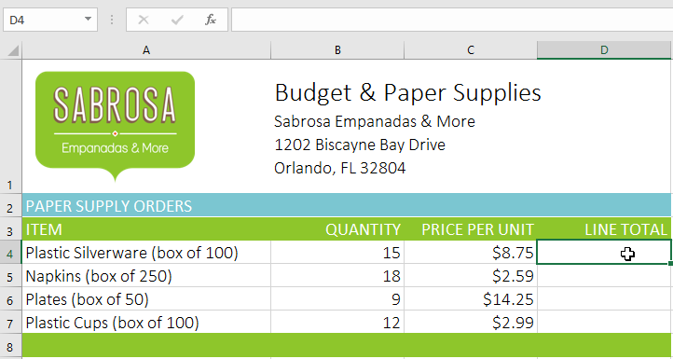
To create a formula using the point-and-click method
Select the cell that will contain the formula. In our example, we'll select cell D4.

Slide 19
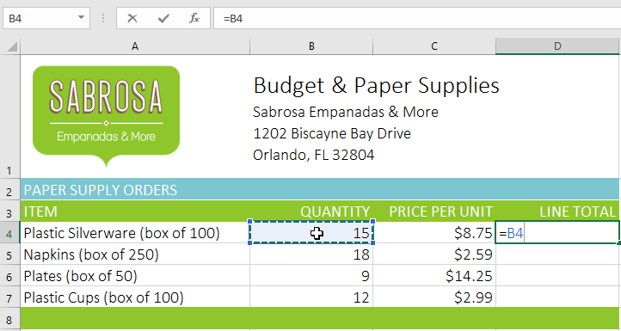
To create a formula using the point-and-click method
Type the equals sign (=) in the formula bar.
Select the cell you want to reference first in the formula: cell B4 in our example. The cell address will appear in the formula.

Slide 20
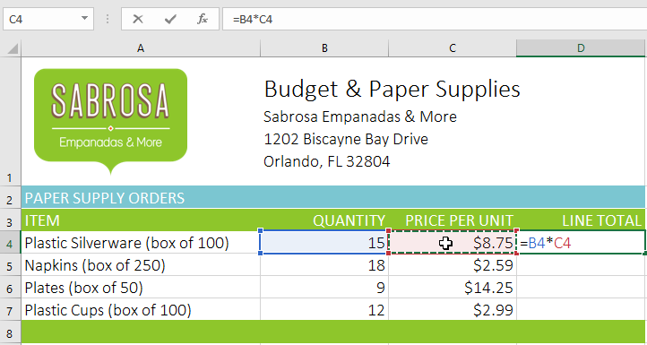
To create a formula using the point-and-click method
Type the mathematical operator you want to use. In our example, we'll type the multiplication sign (*).
Select the cell you want to reference second in the formula: cell C4 in our example. The cell address will appear in the formula.

Slide 21

To create a formula using the point-and-click method
Press Enter on your keyboard. The formula will be calculated, and the value will be displayed in the cell.

Slide 22
Copying formulas with the fill handle
Formulas can also be copied to adjacent cells with the fill handle, which can save a lot of time and effort if you need to perform the same calculation multiple times in a worksheet.
The fill handle is the small square at the bottom-right corner of the selected cell(s).

Slide 23
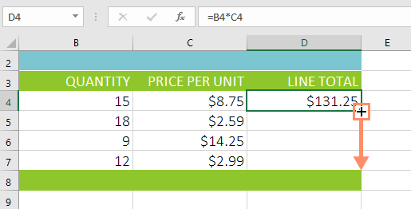
Copying formulas with the fill handle
Select the cell containing the formula you want to copy. Click and drag the fill handle over the cells you want to fill.

Slide 24
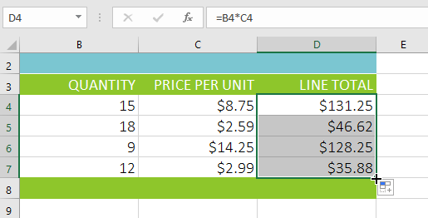
Copying formulas with the fill handle
After you release the mouse, the formula will be copied to the selected cells.

Slide 25
To edit a formula
Sometimes you may want to modify an existing formula.
In the example below, we've entered an incorrect cell address in our formula, so we'll need to correct it.

Slide 26
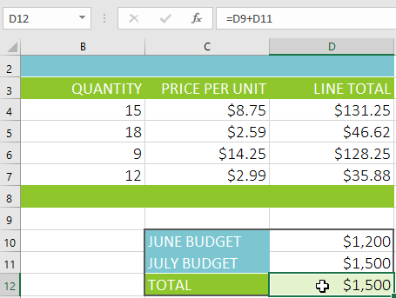
To edit a formula
Select the cell containing the formula you want to edit. In our example, we'll select cell D12.

Slide 27
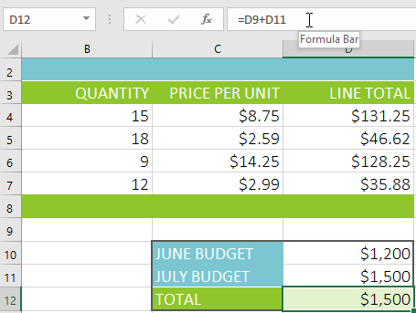
To edit a formula
Click the formula bar to edit the formula. You can also double-click the cell to view and edit the formula directly within the cell.

Slide 28
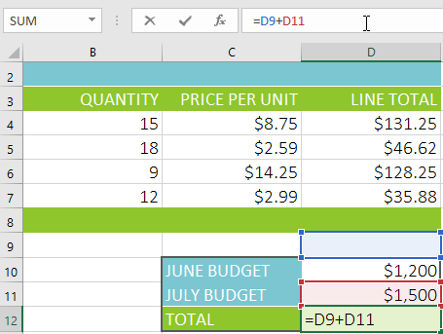
To edit a formula
A border will appear around any referenced cells. In our example, we'll change the first part of the formula to reference cell D10 instead of cell D9.

Slide 29
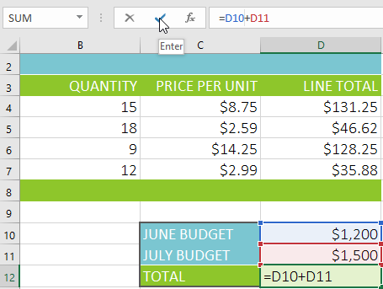
To edit a formula
When you're finished, press Enter on your keyboard or select the Enter command in the formula bar.

Slide 30

To edit a formula
The formula will be updated, and the new value will be displayed in the cell.

Slide 31

To edit a formula
If you change your mind, you can press the Esc key on your keyboard or click the Cancel command in the formula bar to avoid accidentally making changes to your formula.

Slide 32
Excel - Creating More Complex Formulas
You may have experience working with formulas that contain only one operator, like 7+9.
More complex formulas can contain several mathematical operators, like 5+2*8.
When there's more than one operation in a formula, the order of operations tells Excel which operation to calculate first.
To write formulas that will give you the correct answer, you'll need to understand the order of operations.

Slide 33
The order of operations
Excel calculates formulas based on the following order of operations:
Operations enclosed in parentheses
Exponential calculations (3^2, for example)
Multiplication and division, whichever comes first
Addition and subtraction, whichever comes first
A mnemonic that can help you remember the order is PEMDAS, or Please Excuse My Dear Aunt Sally.

Slide 34
The order of operations
Excel calculates formulas based on the following order of operations:
Operations enclosed in parentheses
Exponential calculations (3^2, for example)
Multiplication and division, whichever comes first
Addition and subtraction, whichever comes first
A mnemonic that can help you remember the order is PEMDAS, or Please Excuse My Dear Aunt Sally.

Slide 35
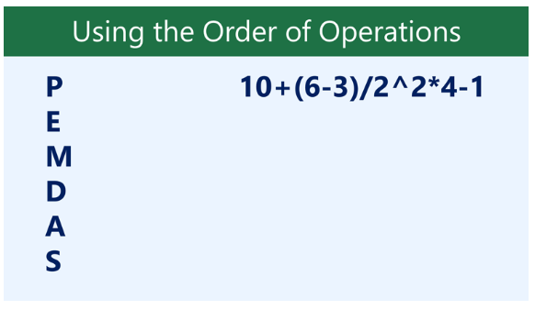
The order of operations
What is the final answer in the expression below?

Slide 36
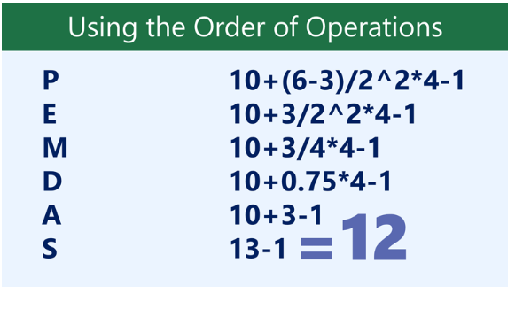
The order of operations

Slide 37
Creating complex formulas
In the example below, we'll demonstrate how Excel uses the order of operations to solve a more complex formula.
Here, we want to calculate the cost of sales tax for a catering invoice.
To do this, we'll write our formula as =(D3+D4+D5)*0.075 in cell D6.
This formula will add the prices of our items, then multiply that value by the 7.5% tax rate (which is written as 0.075) to calculate the answer.

Slide 38
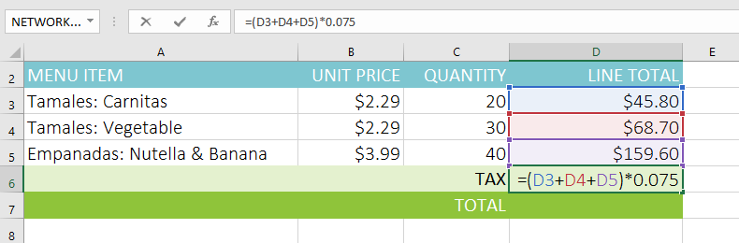
Creating complex formulas
Excel follows the order of operations and first adds the values inside the parentheses: (45.80+68.70+159.60) = 274.10.
It then multiplies that value by the tax rate: 274.10*0.075. The result will show that the sales tax is $20.56.

Slide 39
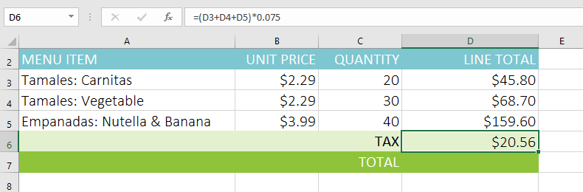
Creating complex formulas
The result will show that the sales tax is $20.56.

Slide 40
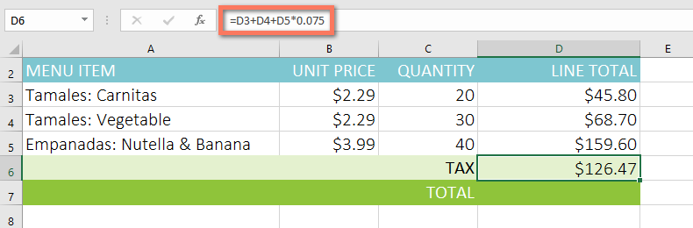
Creating complex formulas
It's especially important to follow the order of operations when creating a formula. Otherwise, Excel won't calculate the results accurately. In our example, if the parentheses are not included, the multiplication is calculated first and the result is incorrect. Parentheses are often the best way to define which calculations will be performed first in Excel.

Slide 41
To create a complex formula using the order of operations
In the example below, we'll use cell references along with numerical values to create a complex formula that will calculate the subtotal for a catering invoice.
The formula will calculate the cost of each menu item first, then add these values.

Slide 42
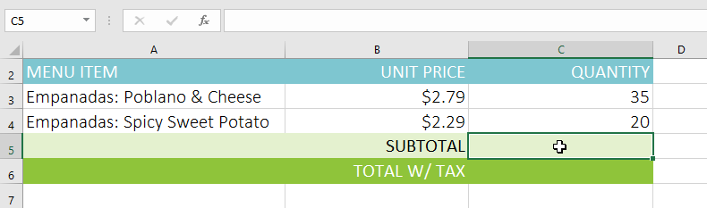
To create a complex formula using the order of operations
Select the cell that will contain the formula. In our example, we'll select cell C5.

Slide 43
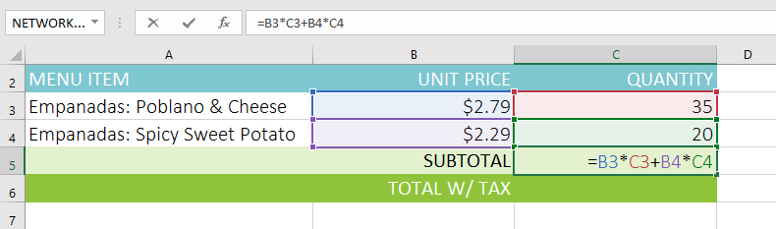
To create a complex formula using the order of operations
Enter your formula. In our example, we'll type =B3*C3+B4*C4. This formula will follow the order of operations, first performing the multiplication: 2.79*35 = 97.65 and 2.29*20 = 45.80. It then will add these values to calculate the total: 97.65+45.80.

Slide 44
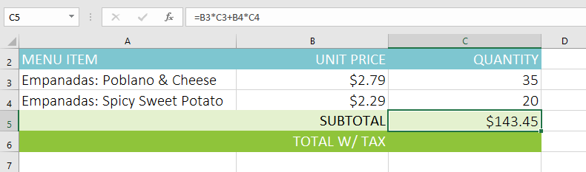
To create a complex formula using the order of operations
Double-check your formula for accuracy, then press Enter on your keyboard. The formula will calculate and display the result. In our example, the result shows that the subtotal for the order is $143.45.

Slide 45

To create a complex formula using the order of operations
You can add parentheses to any equation to make it easier to read. While it won't change the result of the formula in this example, we could enclose the multiplication operations within parentheses to clarify that they will be calculated before the addition.

Slide 46
Excel - Relative and Absolute Cell References
There are two types of cell references: relative and absolute.
Relative and absolute references behave differently when copied and filled to other cells.
Relative references change when a formula is copied to another cell.
Absolute references, on the other hand, remain constant no matter where they are copied.

Slide 47
Relative references
By default, all cell references are relative references.
When copied across multiple cells, they change based on the relative position of rows and columns.
For example, if you copy the formula =A1+B1 from row 1 to row 2, the formula will become =A2+B2.
Relative references are especially convenient whenever you need to repeat the same calculation across multiple rows or columns.

Slide 48
To create and copy a formula using relative references
In the following example, we want to create a formula that will multiply each item's price by the quantity.
Instead of creating a new formula for each row, we can create a single formula in cell D4 and then copy it to the other rows.
We'll use relative references so the formula calculates the total for each item correctly.

Slide 49
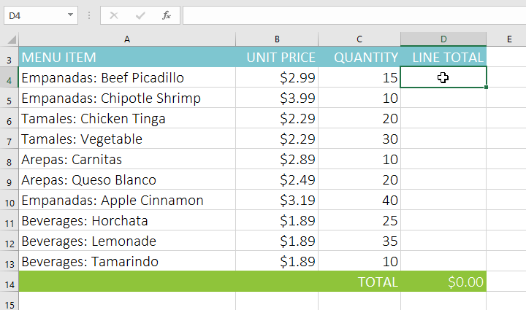
To create and copy a formula using relative references
Select the cell that will contain the formula. In our example, we'll select cell D4.

Slide 50
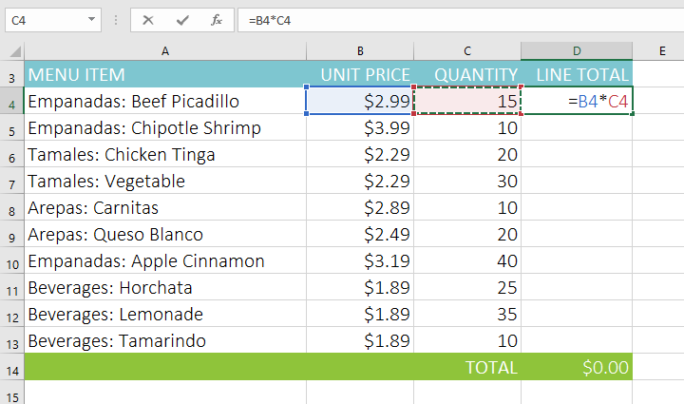
To create and copy a formula using relative references
Enter the formula to calculate the desired value. In our example, we'll type =B4*C4.

Slide 51
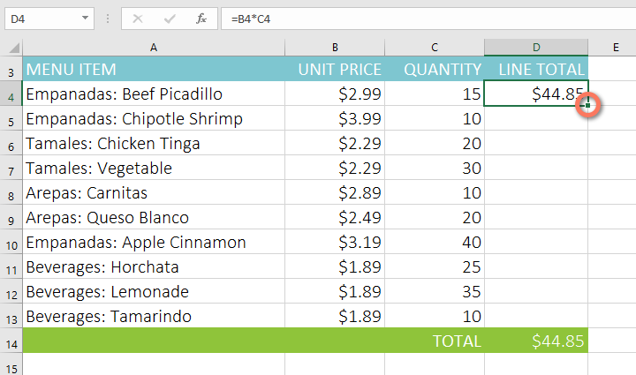
To create and copy a formula using relative references
Press Enter on your keyboard. The formula will be calculated, and the result will be displayed in the cell.
Locate the fill handle in the bottom-right corner of the desired cell. In our example, we'll locate the fill handle for cell D4.

Slide 52
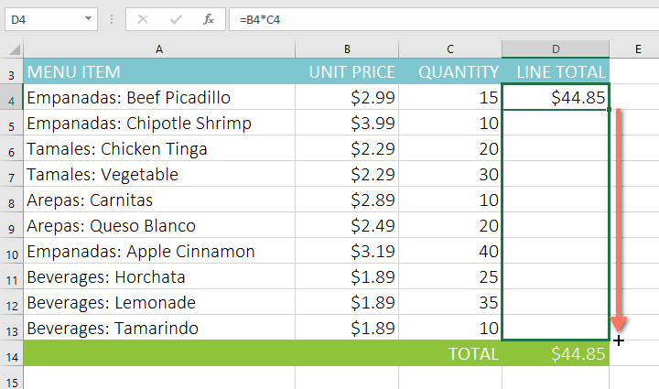
To create and copy a formula using relative references
Click and drag the fill handle over the cells you want to fill. In our example, we'll select cells D5:D13.

Slide 53
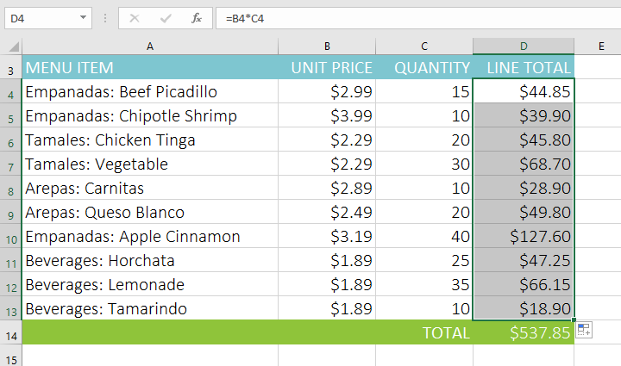
To create and copy a formula using relative references
Release the mouse. The formula will be copied to the selected cells with relative references, displaying the result in each cell.

Slide 54
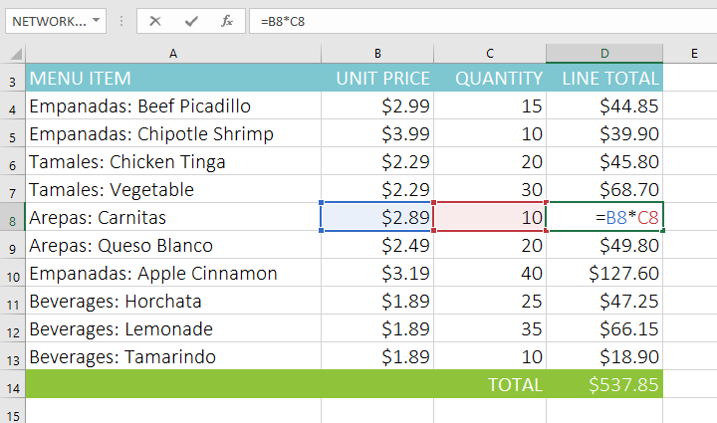
To create and copy a formula using relative references
You can double-click the filled cells to check their formulas for accuracy. The relative cell references should be different for each cell, depending on their rows.

Slide 55
Absolute references
There may be a time when you don't want a cell reference to change when copied to other cells.
Unlike relative references, absolute references do not change when copied or filled.
You can use an absolute reference to keep a row and/or column constant.
An absolute reference is designated in a formula by the addition of a dollar sign ($).
It can precede the column reference, the row reference, or both.

Slide 56
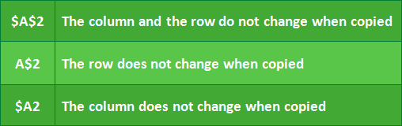
Absolute references
You will generally use the $A$2 format when creating formulas that contain absolute references. The other two formats are used much less frequently.
When writing a formula, you can press the F4 key on your keyboard to switch between relative and absolute cell references,

Slide 57
To create and copy a formula using absolute references
In the example below, we'll use cell E2 (which contains the tax rate of 7.5%) to calculate the sales tax for each item in column D.
To make sure the reference to the tax rate stays constant—even when the formula is copied and filled to other cells—we'll need to make cell $E$2 an absolute reference.

Slide 58
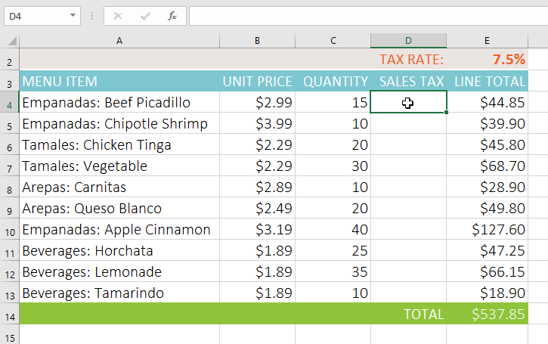
To create and copy a formula using absolute references
Select the cell that will contain the formula. In our example, we'll select cell D4.

Slide 59
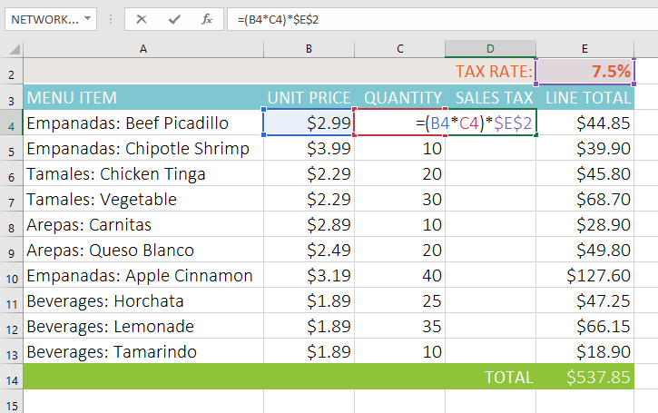
To create and copy a formula using absolute references
Enter the formula to calculate the desired value. In our example, we'll type =(B4*C4)*$E$2, making $E$2 an absolute reference.

Slide 60
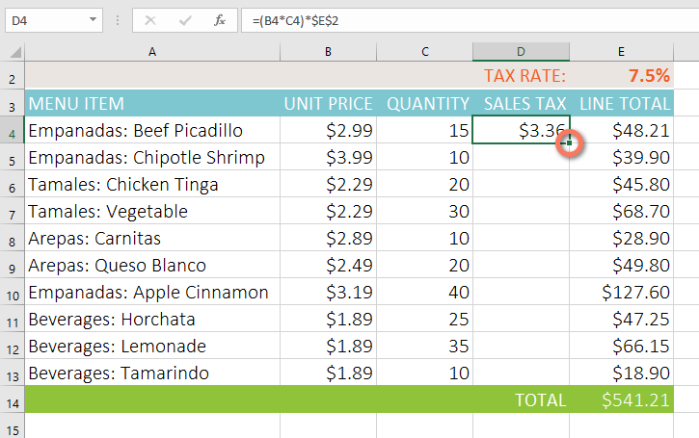
To create and copy a formula using absolute references
Press Enter on your keyboard. The formula will calculate, and the result will display in the cell.
Locate the fill handle in the bottom-right corner of the desired cell. In our example, we'll locate the fill handle for cell D4.

Slide 61
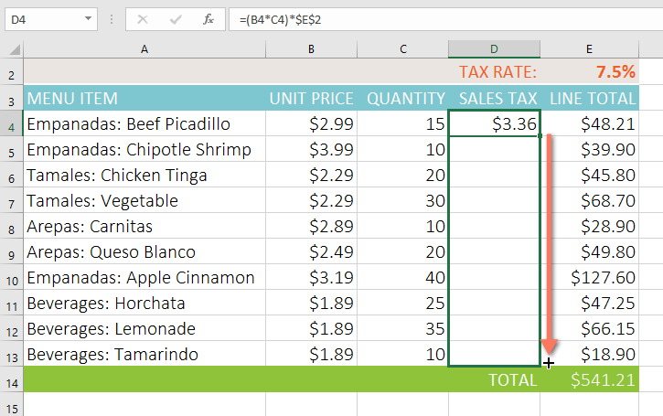
To create and copy a formula using absolute references
Click and drag the fill handle over the cells you want to fill (cells D5:D13 in our example).

Slide 62
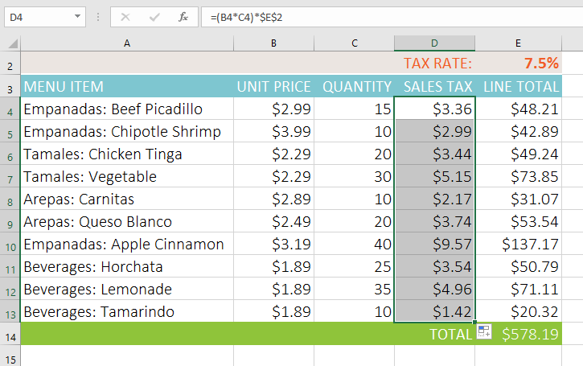
To create and copy a formula using absolute references
Release the mouse. The formula will be copied to the selected cells with an absolute reference, and the values will be calculated in each cell.

Slide 63
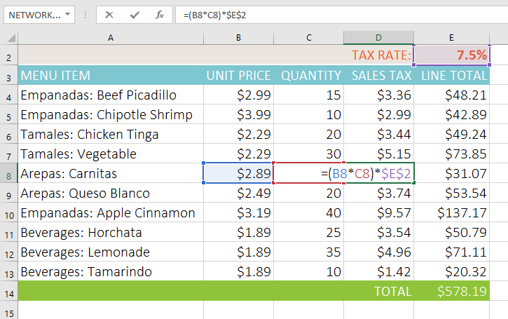
To create and copy a formula using absolute references
You can double-click the filled cells to check their formulas for accuracy. The absolute reference should be the same for each cell, while the other references are relative to the cell's row.

Slide 64
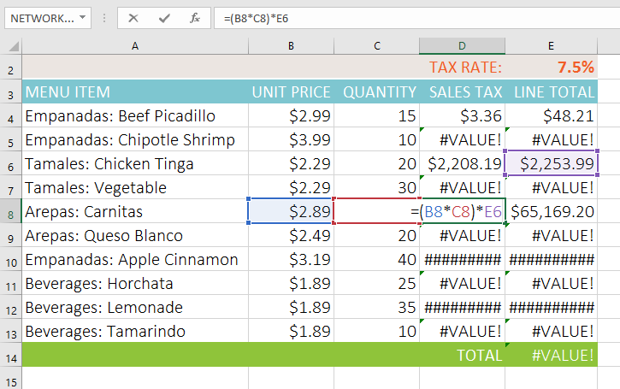
To create and copy a formula using absolute references
Be sure to include the dollar sign ($) whenever you're making an absolute reference across multiple cells. The dollar signs were omitted in the example below. This caused Excel to interpret it as a relative reference, producing an incorrect result when copied to other cells.

Slide 65
Excel - Functions
A function is a predefined formula that performs calculations using specific values in a particular order.
Excel includes many common functions that can be used to quickly find the sum, average, count, maximum value, and minimum value for a range of cells.
In order to use functions correctly, you'll need to understand the different parts of a function and how to create arguments to calculate values and cell references.

Slide 66
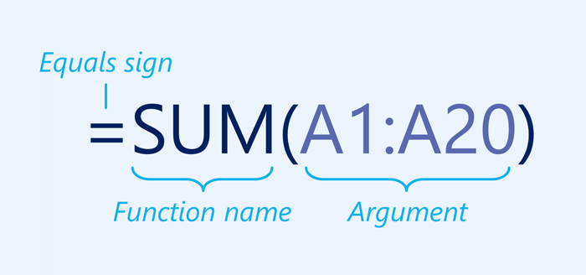
The parts of a function
In order to work correctly, a function must be written a specific way, which is called the syntax. The basic syntax for a function is the equals sign (=), the function name (SUM, for example), and one or more arguments. Arguments contain the information you want to calculate. The function in the example below would add the values of the cell range A1:A20.

Slide 67
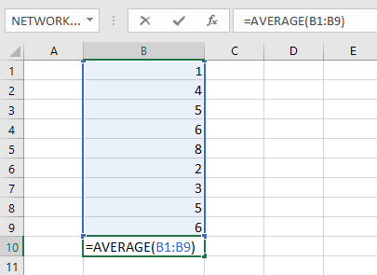
Working with arguments
Arguments can refer to both individual cells and cell ranges and must be enclosed within parentheses. You can include one argument or multiple arguments, depending on the syntax required for the function.
For example, the function =AVERAGE(B1:B9) would calculate the average of the values in the cell range B1:B9. This function contains only one argument.

Slide 68
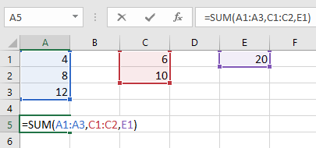
Working with arguments
Multiple arguments must be separated by a comma. For example, the function =SUM(A1:A3, C1:C2, E1) will add the values of all of the cells in the three arguments.

Slide 69
Creating a function
There are a variety of functions available in Excel. Here are some of the most common functions you'll use:
SUM: This function adds all of the values of the cells in the argument.
AVERAGE: This function determines the average of the values included in the argument. It calculates the sum of the cells and then divides that value by the number of cells in the argument.
COUNT: This function counts the number of cells with numerical data in the argument. This function is useful for quickly counting items in a cell range.
MAX: This function determines the highest cell value included in the argument.
MIN: This function determines the lowest cell value included in the argument.

Slide 70
To create a function using the AutoSum command
The AutoSum command allows you to automatically insert the most common functions into your formula, including SUM, AVERAGE, COUNT, MAX, and MIN.
In the example below, we'll use the SUM function to calculate the total cost for a list of recently ordered items.

Slide 71
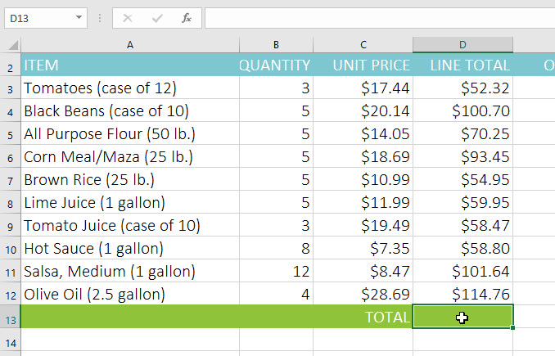
To create a function using the AutoSum command
Select the cell that will contain the function. In our example, we'll select cell D13.

Slide 72
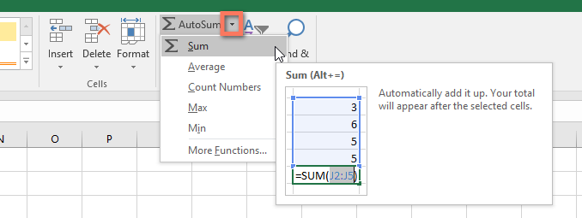
To create a function using the AutoSum command
In the Editing group on the Home tab, click the arrow next to the AutoSum command. Next, choose the desired function from the drop-down menu. In our example, we'll select Sum.

Slide 73
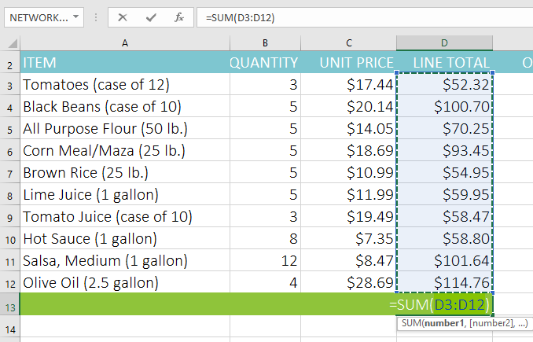
To create a function using the AutoSum command
Excel will place the function in the cell and automatically select a cell range for the argument. In our example, cells D3:D12 were selected automatically; their values will be added to calculate the total cost. If Excel selects the wrong cell range, you can manually enter the desired cells into the argument.

Slide 74
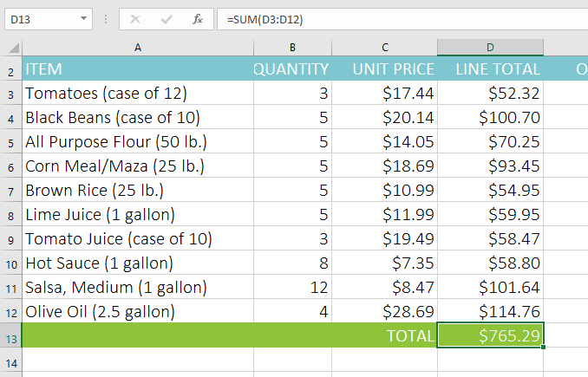
To create a function using the AutoSum command
Press Enter on your keyboard. The function will be calculated, and the result will appear in the cell. In our example, the sum of D3:D12 is $765.29.

Slide 75
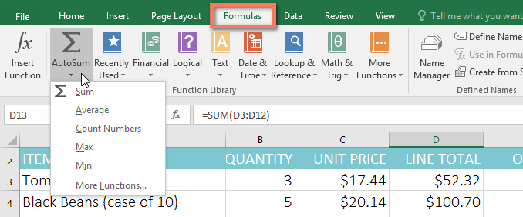
To create a function using the AutoSum command
The AutoSum command can also be accessed from the Formulas tab on the Ribbon.
You can also use the Alt+= keyboard shortcut instead of the AutoSum command.
To use this shortcut, hold down the Alt key and then press the equals sign.

Slide 76
To enter a function manually
If you already know the function name, you can easily type it yourself.
In the example below (a tally of cookie sales), we'll use the AVERAGE function to calculate the average number of units sold by each troop.

Slide 77
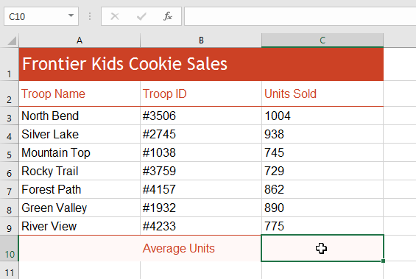
To enter a function manually
Select the cell that will contain the function. In our example, we'll select cell C10.

Slide 78

To enter a function manually
Type the equals sign (=), then enter the desired function name.
You can also select the desired function from the list of suggested functions that appears below the cell as you type. In our example, we'll type =AVERAGE.

Slide 79

To enter a function manually
Enter the cell range for the argument inside parentheses.
In our example, we'll type (C3:C9). This formula will add the values of cells C3:C9, then divide that value by the total number of values in the range.

Slide 80

To enter a function manually
Press Enter on your keyboard. The function will be calculated, and the result will appear in the cell. In our example, the average number of units sold by each troop is 849.

Slide 81
The Function Library
While there are hundreds of functions in Excel, the ones you'll use the most will depend on the type of data your workbooks contain.
There's no need to learn every single function, but exploring some of the different types of functions will help as you create new projects.
You can even use the Function Library on the Formulas tab to browse functions by category, including Financial, Logical, Text, and Date & Time.

Slide 82

The Function Library
To access the Function Library, select the Formulas tab on the Ribbon. Look for the Function Library group.

Slide 83
To insert a function from the Function Library
In the example below, we'll use the COUNTA function to count the total number of items in the Items column.
Unlike COUNT, COUNTA can be used to tally cells that contain data of any kind, not just numerical data.

Slide 84

To insert a function from the Function Library
Select the cell that will contain the function. In our example, we'll select cell B17.

Slide 85

To insert a function from the Function Library
Click the Formulas tab on the Ribbon to access the Function Library.
From the Function Library group, select the desired function category. In our example, we'll choose More Functions, then hover the mouse over Statistical.

Slide 86

To insert a function from the Function Library
Select the desired function from the drop-down menu. In our example, we'll select the COUNTA function, which will count the number of cells in the Items column that are not empty.

Slide 87

To insert a function from the Function Library
The Function Arguments dialog box will appear. Select the Value1 field, then enter or select the desired cells. In our example, we'll enter the cell range A3:A12. You can continue to add arguments in the Value2 field, but in this case we only want to count the number of cells in the cell range A3:A12.
When you're satisfied, click OK.

Slide 88

To insert a function from the Function Library
The function will be calculated, and the result will appear in the cell. In our example, the result shows that 10 items were ordered.

Slide 89
To use the Insert Function command
In the example below, we want to find a function that will calculate the number of business days it took to receive items after they were ordered.
We'll use the dates in columns E and F to calculate the delivery time in column G.

Slide 90

To use the Insert Function command
Select the cell that will contain the function. In our example, we'll select cell G3.

Slide 91

To use the Insert Function command
Click the Formulas tab on the Ribbon, then click the Insert Function command.

Slide 92

To use the Insert Function command
The Insert Function dialog box will appear.
Type a few keywords describing the calculation you want the function to perform, then click Go. In our example, we'll type count days, but you can also search by selecting a category from the drop-down list.

Slide 93

To use the Insert Function command
Review the results to find the desired function, then click OK.
In our example, we'll choose NETWORKDAYS, which will count the number of business days between the ordered date and received date.

Slide 94

To use the Insert Function command
The Function Arguments dialog box will appear. From here, you'll be able to enter or select the cells that will make up the arguments in the function. In our example, we'll enter E3 in the Start_date field and F3 in the End_date field.
When you're satisfied, click OK.

Slide 95

To use the Insert Function command
The function will be calculated, and the result will appear in the cell. In our example, the result shows that it took four business days to receive the order.

Slide 96

To use the Insert Function command
Like formulas, functions can be copied to adjacent cells. Simply select the cell that contains the function, then click and drag the fill handle over the cells you want to fill. The function will be copied, and values for those cells will be calculated relative to their rows or columns.

Slide 97


Slide 98
THANK YOU

